Slide 1

Travel
Kristina Wigginton
Travel Accountant
962-3838
kdwigginton@eou.edu
travel@eou.edu
https://www.eou.edu/busserv/travel/

Slide 2
EOU Travel Policies and Procedures
It is the responsibility of the employee to be informed and compliant with EOU’s traveling policies and procedures.
EOU’s travel policy can be found on the EOU Travel Page.
Please see the EOU Travel Summary and Procedures for the current per diem rates and the High Cost Localities for the list of high cities (within the continental U.S.)
Know before you go Quick Reference Guide

Slide 3
Key Contacts
Travel Reimbursement Questions & Assistance
  Accounts Payable Travel Account: Kristina Wigginton 2-3838 / kdwigginton@eou.edu or travel@eou.edu
Student Travel Questions
  Student Affairs: Kaylin Fergus 2-3548 / kfergus@eou.edu
International Travel Insurance/Foreign Travel Authorization Questions
  Risk Management: Tonya Evans 2-3773 / tevans@eou.edu

Slide 4
Requirements Prior to Travel
(Employees, Representatives & Official Guests)
Domestic:
  Department approval is required prior to departure, for travel within the continental U.S.
Foreign:
  EOU requires a Foreign Travel Authorization be submitted for all international travel at least 25 business days before departure and before any travel bookings are made
    This includes: airfare, conference registration, car rentals, etc.
    Insurance is required for all international travel
    The Defense Travel Management Office maintains travel rates for non-foreign overseas localities
    The U.S. Dept. of State maintains travel rates for foreign localities

Slide 5
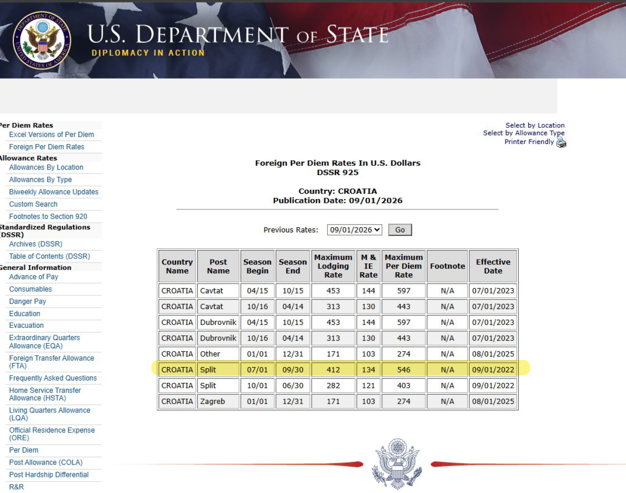
Example:
Destination: Split, Croatia
Meal/Incidental Per Diem
$134
Breakfast $33.50
Lunch $33.50
Dinner $67.00
Lodging Per Diem
$412/night excluding tax

Slide 6
Travel Advances
(Employees, Representatives & Official Guests)
Before the Trip:
  If you require funds prior to your trip, please submit a Travel Advance via the Laserfiche form to the Accounts Payable Office at least two weeks prior to departure.
  Advances are issued for 80% of a travelers estimated out-of-pocket expenses and will not be issued for less than $200
  All previous advances must be settled before a new one will be issued
  Travel advance amounts are to be deducted from the total out of pocket expenses on the travelers reimbursement request

Slide 7
Transportation
(Employees, Representatives & Official Guests)
Planning the Trip:
  Travelers should be mindful of their travel budget, and be sure that the funding source is appropriate for the type of trip. Travelers are responsible for knowing the travel rates and policies prior to departure.
Travelers should choose the most commonly traveled routes and economical options that meet their business needs. This includes seeking lodging accommodation within current rates, mileage vs. commercial transportation, etc.
  Vehicles may be rented locally from Legacy Ford, MJ Goss and The Other Guys Auto
  At available locations, EOU employees on official business must take advantage of our State of Oregon contract with Enterprise/National or Hertz Car Rental.
    Discount code for Enterprise/National: XZ46WOR
    Discount code for Hertz: 67309

Slide 8
Travel
(Employees, Representatives & Official Guests)
Planning the Trip:
  Airfare:
    Travelers may use the agency or airline of their choice as long as it is the most reasonable and cost effective flight available to meet their needs
      Airline upgrades, seat selection fees and pre-boarding are unallowable
  Lodging:
    Ensure that your nightly room rate (excluding tax) is under the current lodging per diem rate as found on the EOU Travel Summary & Procedures
    Any amount above the current lodging per diem rate will not be reimbursed
    Conference lodging is reimbursed at actual cost if the traveler is staying at a designated conference hotel. For the conference lodging to be reimbursed for actual cost, documentation from the conference, listing the designated hotels and room rates must be attached.

Slide 9
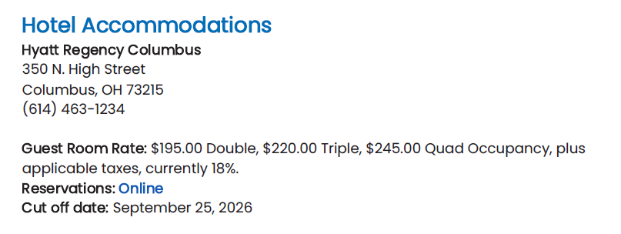
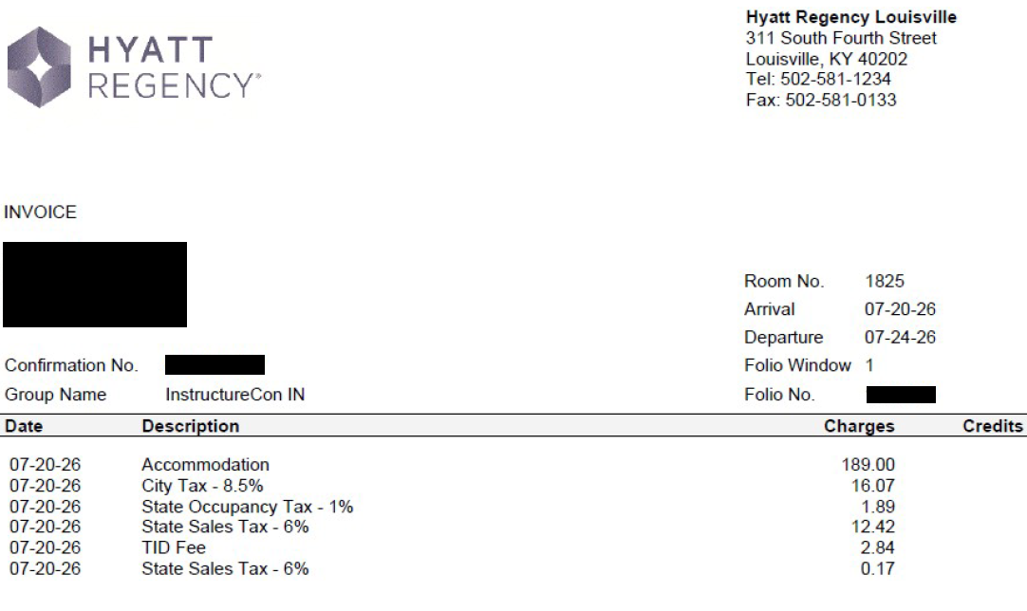
Screen print the conference rate. Usually found on the website prior to conference.
Sometimes the hotel will
have the conference name
in the Group Name of the folio

Slide 10
Travel Reimbursement
(Employees, Representatives & Official Guests)
After the Trip:
  Travel reimbursements should be submitted within 30 days after the trip has been completed
    Reimbursements must be signed by claimant and appropriate budget authority
  Receipts are not required for personal vehicle mileage or for meals and incidentals (unless hosting or group travel)
    Personal vehicle mileage is city to city, per the Oregon Mileage chart for in-state travel, or city to city using a mapping software such as Google Maps

Slide 11
Travel Reimbursement
(Employees, Representatives & Official Guests)
After the Trip:
  The following documentation is required for reimbursement:
    Proof of Business Purpose (a meeting or conference agenda, email letter of invitation or typed itinerary)
      This agenda should include dates and times of the conference/meeting and what was included in the conference (i.e. meals/banquets). If a formal agenda is not available, a typed summary of meeting times and locations must be attached
    Itemized receipts for lodging (booking confirmations will not be accepted)
    Itemized receipts for transportation (Uber, airfare, car rental), fuel (other than personal vehicle mileage), miscellaneous expenses (baggage, airport parking)
    For foreign travel, a copy of the signed foreign travel authorization
    For travel involving students, a copy of the fully signed and completed student travel packet

Slide 12

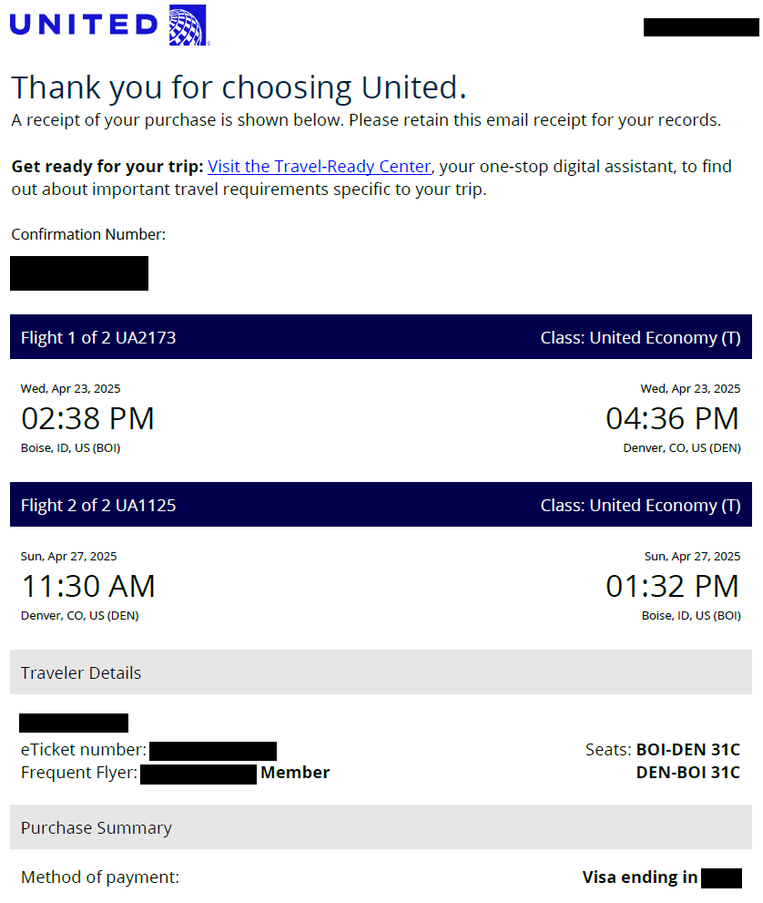
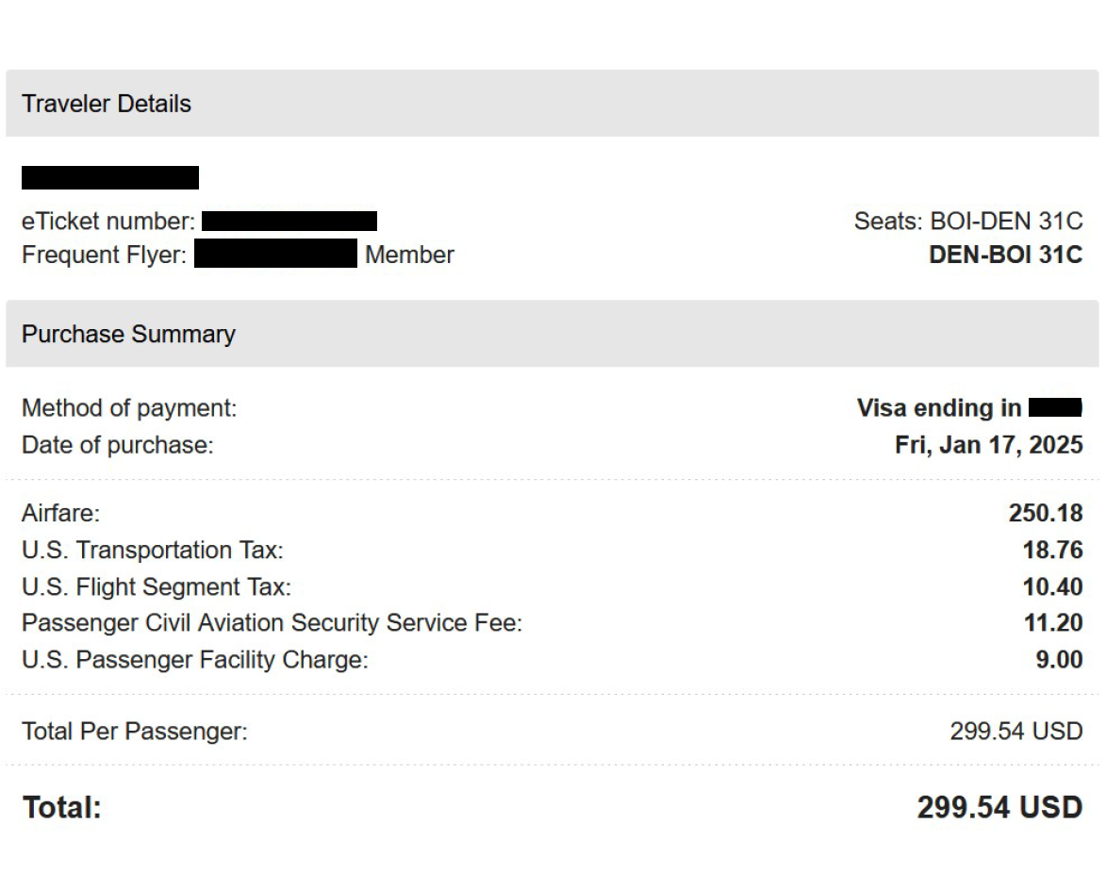
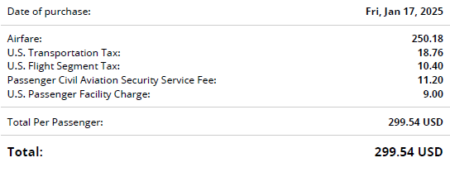

Slide 13
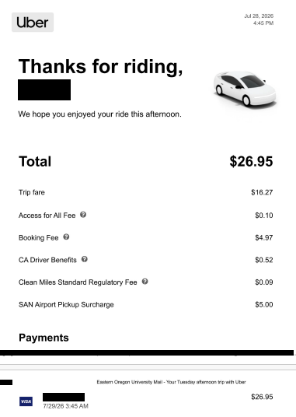
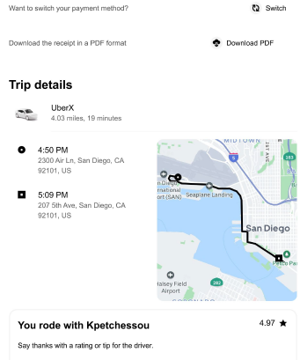
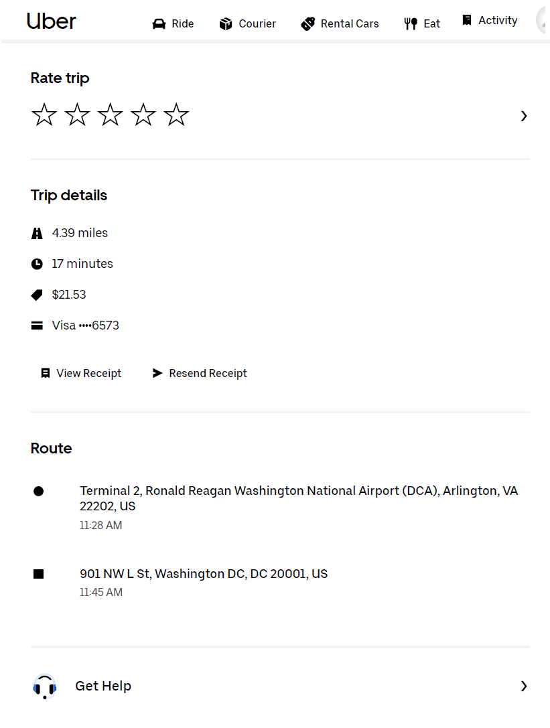

Slide 14
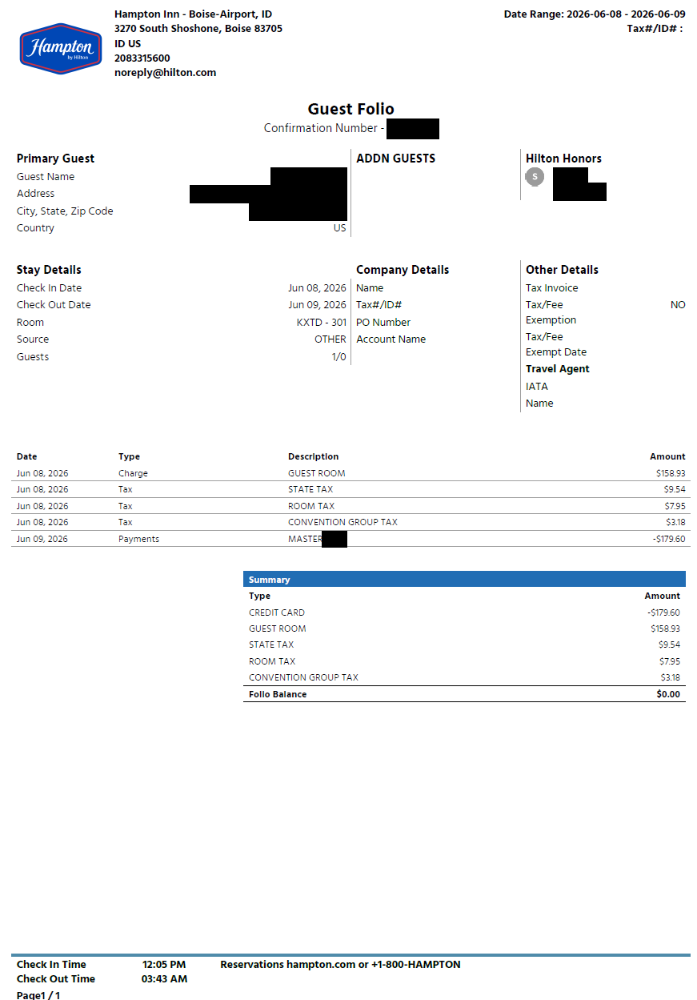
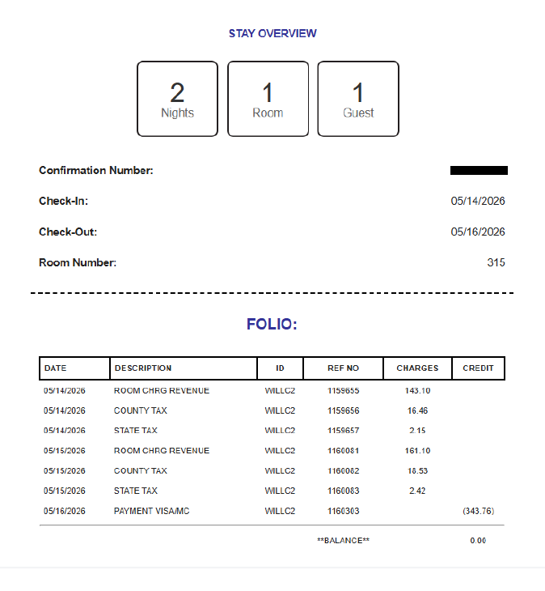

Slide 15
Student Travel
All student group travel requires a complete Student Travel Packet before any arrangements are made. Student Travel Packets must be approved 20 business days prior to departure or 25 business days for international travel.
Travelers should contact their designated college office or the Center of Student Involvement to facilitate travel arrangements (excluding Athletics).
  Contacts:
    Student Affairs Office:
      Kaylin Fergus 2-3548 / kfergus@eou.edu
    CSI Office:
      Kelly Marriott 2-3705 / kmarriott@eou.edu
    Risk Management Office:
      Tonya Evans 2-3773 / tevans@eou.edu

Slide 16
Student Travel
The Student Travel packet must be approved and signed by the following individuals prior to departure:
  Designated Responsible Person (DRP)
    An EOU faculty or staff member traveling with students must serve as the Designated Responsible Party (DRP)
  Appropriate Budget Authority or The CSI Director
  Risk Manager
  Vice President for Student Affairs
No travel arrangements are to be made until the Student Travel Packet is approved by all parties listed above
  This includes: airfare, conference registration, car rentals, etc.

Slide 17

Student Travel
Student Group Meals
For student group travel, meals can be reimbursed for actual cost, based on itemized meal receipts
  Meals reimbursed at actual cost can not be in excess of the meal per diem rate for all individuals in attendance
  Tips for meals should not exceed 15%
In lieu of actual meal receipts, the DRP can be reimbursed for meal per diem using a trip meal expense worksheet
  The trip meal expense worksheet must include signatures from each student who received meal per diem, verifying the amount of cash received

Slide 18
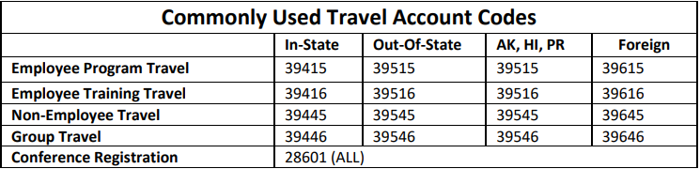
Travel Account Codes
*For overtime meals on one day trips, please use account code 28502
Overtime meals on one day trips are allowed as follows:
Departure before 6:00 AM: breakfast allowed
Return after 7:00 PM: dinner allowed
Note: Lunch will NOT be reimbursed

Slide 19
Unallowable Expenses
Gratuities for services (taxi drivers, baggage handlers, valet)
Seat upgrades or seat selections fees for airfare or any other transportation
Fuel options on vehicle rentals or other optional services or insurance (LDW/CDW is allowed)
Alcoholic beverages
Travel insurance except as required for international travel
Room service
Personal entertainment
Automotive repair on personal vehicles
Personal items lost while traveling
Travel expenses for companions not affiliated with EOU

Slide 20
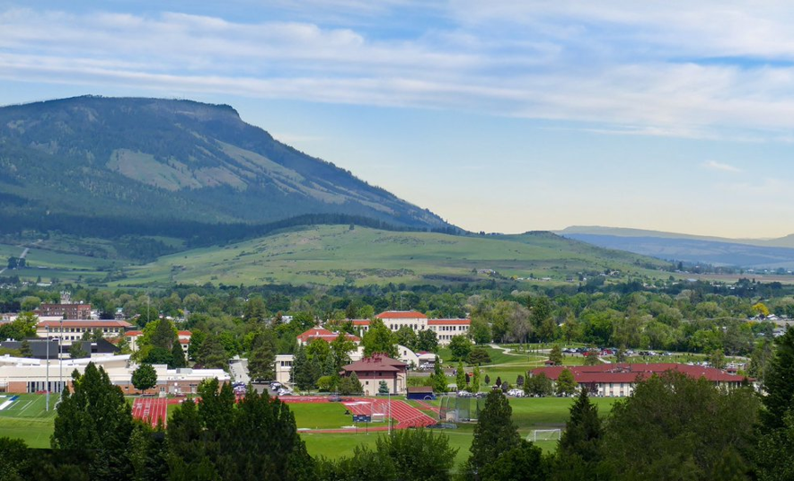
Thank You!
Questions
Email travel@eou.edu
Or
kdwigginton@eou.edu

