Slide 1
Renewing and Extending the Value of the EOU Masters in Business Program
Created by: Gary Keller, Ph.D. Professor College of Business Eastern Oregon University gkeller@eou.edu
A Prototype Proposal to Increase Value Added Academic Products and Services of a Rural University: G. Keller

Slide 2
Basis of the Renewal of the Masters in Business Program
The basis of the renewal proposal for Eastern Oregon University’s Masters in Business is to demonstrate the inherent flexibility and value added capacity that a rural university such as EOU can provide to its locale and surrounding micropolises.

Slide 3
Applicability to Rural Universities
The renewal proposal is not focused solely on EOU; rather EOU’s leadership in this type of MBA program delivery can serve as a template for other domestic and global rural universities to leverage their existing accreditation designation, faculty, capital assets and most importantly, their intimate knowledge of the needs of rural population centers and unique existing and future commercial requirements.

Slide 4
Opportunity for Rural Universities
Rural universities have an opportunity to have a significant role in assisting developed countries’ rural areas not only sustain their local economies but also contribute to assisting developing economies strengthen their capacities to educate their citizens and accelerate solving issues endemic to agricultural and natural resource dependent economies. The need for rural universities to play an active role is clear and compelling

Slide 5
Need for Rural Universities to Offer Innovative Masters Programs
According to the World Bank,
For the 70 percent of the world's poor who live in rural areas, agriculture is the main source of income and employment. But depletion and degradation of land and water pose serious challenges to producing enough food and other agricultural products to sustain livelihoods here and meet the needs of urban populations.
47% 2013
Rural population (% of total population)
37.6% 2011
Agricultural land (% of land area)
Source: data.worldbank.org/topic/agriculture-and-rural-development

Slide 6
Renewal Principle #1: Major MBA Curricula Change is Occurring
The Association to Advance Collegiate Schools of Business (AACSB) estimates that 75% of business schools have made some changes to their curricula.
The leading MBA programs (Yale, Stanford, Wharton) are de-emphasizing traditional disciple –based courses…in favor of a focus on leadership skills, innovation, social responsibility and a global perspective. Source: U.S. News and World Report

Slide 7
Renewal Principle #2: Creative Destruction of MBA Curricula
“In many instances, you are seeing them (MBA curricula) being destroyed and rebuilt.” John Fernandez (AACSB)

Slide 8
Renewal Principle #3: Preparing Students for Businesses That Don’t Exist
“It’s education that’s meant to take us into this future that we can’t grasp...children starting school this year will be retiring in (2072)…Nobody has a clue…what the world will look like in five years time. And yet we’re meant to be educating them for it (2072). So the unpredictability is extraordinary.” Sir Ken Robinson
“Today they (business leaders) work in hedge funds and biotechnology…None of that existed 20 years ago.” Wharton Dean Thomas Robertson

Slide 9
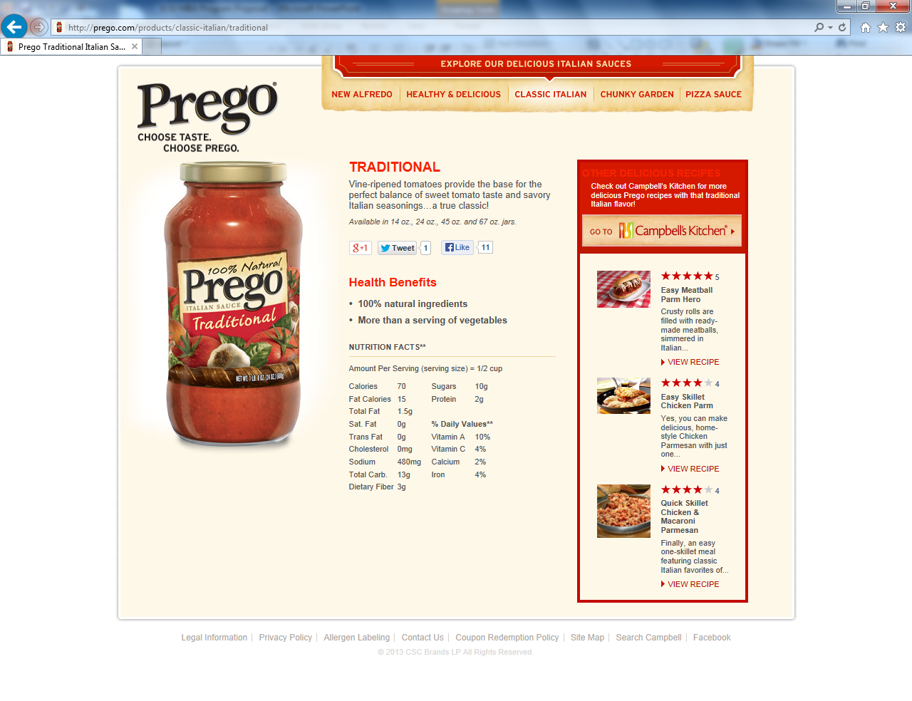
. Renewal Principle #4
There is no best curriculum.

Slide 10
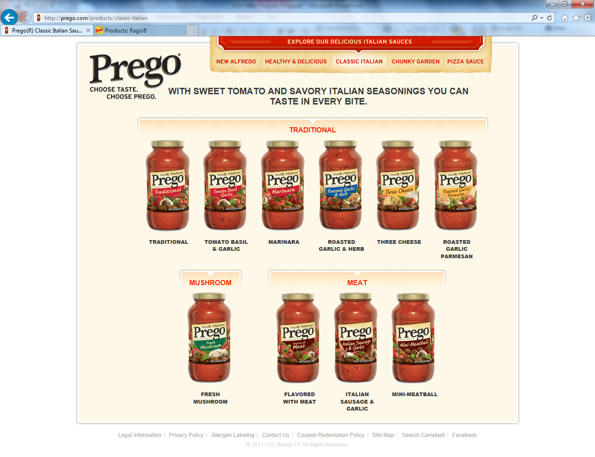
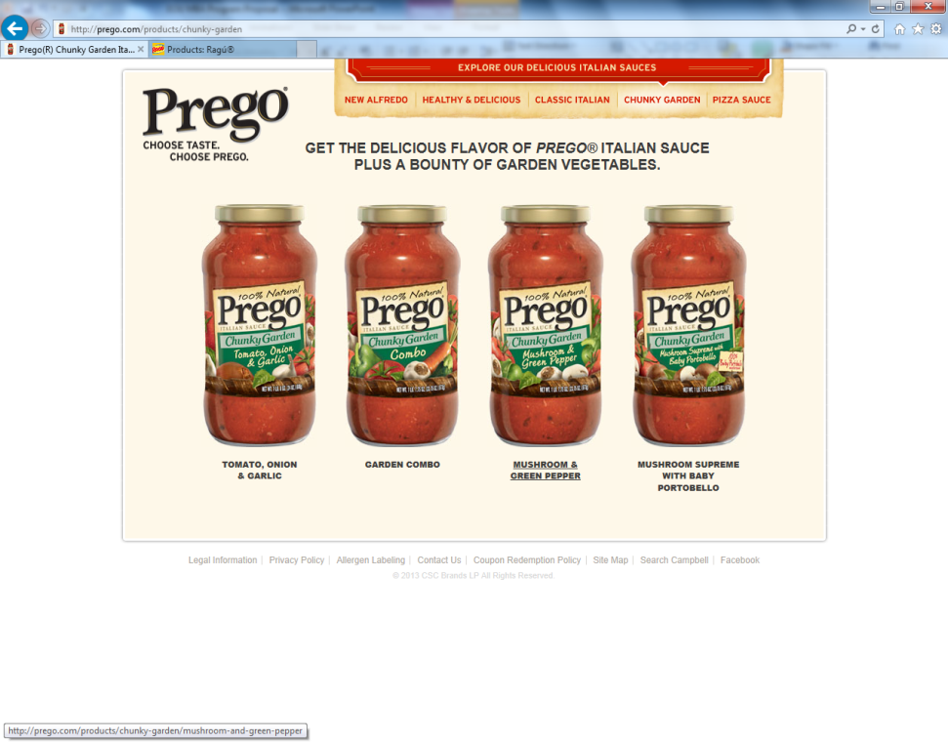
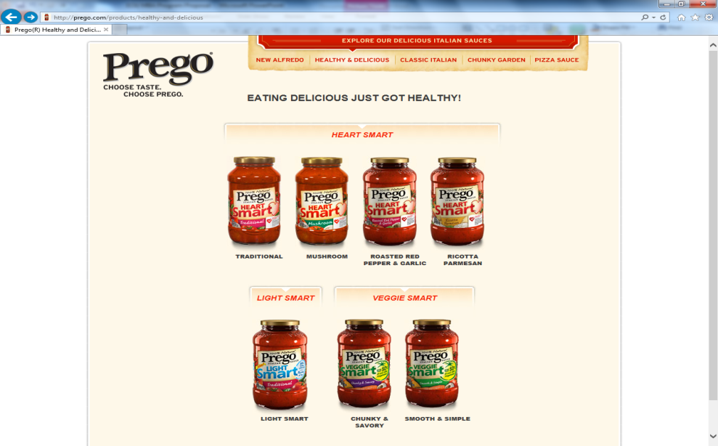
Renewal Principle #5: There are only the best curricula.

Slide 11
Renewal Principle #6: We Exist in a Crowded Marketplace
The “Business School Data Trends and 2010 List of Accredited Schools”, issued by AACSB International reports there are over 4,000 MBA programs in the US, offered by 454 institutions.
Most candidates choose part-time programs (56.9%), followed by full-time programs (33.8%).
America offers the world’s highest number of MBA programs.

Slide 12
Renewal Principle #7: Demand for MBAs & MSs Has Not Declined
Over the long term the total number of business master’s degrees (MBA plus MS) awarded each year by U.S. schools has grown rapidly, from 26,000 in 1970 to 168,000 in 2009.
But growth in recent years has been in one-year Specialized Master of Science (MS) degrees in business, while traditional two-year MBA degrees have leveled off.
http://www.forbes.com/sites/ronaldyeaple/2012/05/30/is-the-mba-obsolete/

Slide 13
Renewal Principle #8: EOU’s MBA Currently Offers a Single Masters Curriculum
Is EOU’s MBA current offering competitive in its service area?
Question 1. Will the current EOU MBA curriculum bring the MBA program closer or take it further from actualizing its vision?
“The EOU MBA program will be the premier MBA program in the Pacific Northwest, recognized for inspiring students to transform the world through innovative practices and services.”
And
Question 2. Will the current EOU MBA curriculum bring the MBA program closer or take it further from actualizing its mission?
“The EOU MBA program advances business leaders who, through self-mastery, flourish in uncertainty, create long-term enterprises and inspire organizational prosperity.”

Slide 14
Renewal Principle #9: The Blue Ocean Strategy was the inspiration of this proposal.
Red Ocean Strategy
Blue Ocean Strategy
Compete in existing market space.
Beat the competition.
Exploit existing demand.
Make the value/cost trade-off.
Align the whole system of a company's activities with its strategic choice of differentiation or low cost.
Create uncontested market space.
Make the competition irrelevant.
Create and capture new demand.
Break the value/cost trade-off.
Align the whole system of a company's activities in pursuit of differentiation and low cost.

Slide 15
Overarching Renewal PROGRAM Principle
SUCCEED
S U C C E E D
U N R O X T E
S D E L C H T
T E A L E I E
A R T A L C R
I S E B A M
N T O L I
A R N
N A E
D T D
E

Slide 16
SUCCEED Enables EOU Masters in Business Graduates to:
Master Self GROW FLOURISH PROSPER
TRANSFORM THE WORLD

Slide 17
EOU Masters in Business Approach: SUCCEED
Guiding Principle to Actualize SUCCEED:
The EOU Masters in Business program advances business leaders who, through self-mastery, flourish in uncertainty, create long-term enterprises and inspire organizational prosperity.
To accomplish this mission we:
Accept as true that the free market economic system provides global citizens the optimal path to achieving individual and social goals and promotes peace between nation-states.
Serve adult, part-time students who reside primarily in the Pacific Northwest.
Offer our students, regardless of geographic location, a variety of Masters in Business degrees, content delivery methods, curricula and course options that will prepare them to flourish in unpredictable circumstances.
Believe that imagination, implementation and an international outlook will provide American businesses and non governmental organizations with an enduring competitive advantage.
Have faith in the proposition that determination, hard work, integrity and self-mastery are the most important characteristics of a graduate of the EOU Masters in Business degree programs.

Slide 18
EOU Masters in Business Teaching Principles
Collaboration – EOU Masters faculty include academically qualified members from the entire EOU faculty (integrative methodology).
Contemporary – EOU Masters faculty consist of teachers noted for their interactive instructional methodology, are active practitioners and engage in the creation of new knowledge by way of original research.
International experience – EOU Masters faculty members have worldwide teaching, presentation and consulting credentials to expand the scope and perspective of the EOU Masters in Business programs.

Slide 19
EOU Masters in Business Distinctive Curricula 1+1 = 7
Two Masters Degrees - Eight Options
MBA -Traditional (existing curriculum with refurbishments) and use of existing delivery and cohort model.
MyMBA – Personalized
MBA – Fast Track - Accelerated
MBA – Online
MSM – New
MSM – Online
MyMSM – Personalized

Slide 20
Existing EOU MBA Curriculum
BA 515 Marketing Strategies and Techniques (5 credits)
BA 520 Financial Strategies and Techniques (5 credits)
BA 530 Contemporary Management & Organization (5 credits)
BA 540 Operations Management (5 credits)
BA 550 Management Information Systems (5 credits)
BA 560 Business Ethics, Government, and Society (5 credits)
BA 570 International Business: Strategies & Techniques (5 credits)
BA 580 Competition and Strategic Management (5 credits)
BA 699 Master Project (5 credits)

Slide 21
Option 1: MBA -Traditional (existing curriculum with refurbishments) and use of existing delivery and cohort model.
Refurbishment Recommendations
Introduction of an “onboarding” Friday night -Saturday seminar the weekend before the first course begins. The seminar will familiarize new Masters students to the curriculum, each other and faculty, APA, grading, quality expectations and other operational components of the program including the selection of their integrated management project (BA 699) topic.
Integration of the toll-gate process into the MBA Traditional curriculum to evaluate student success.
Assignment of a Faculty Counselor to each student.
A complete refresh of the content of each existing course in the curriculum to insure the content, objectives and outcomes are contemporary. A decision to maintain or eliminate/replace courses should be rendered as part of the refurbishment procedure.
An analysis of course sequencing should be made in partnership with the College of Education to determine if the existing course arrangement facilitates or hinders learning and knowledge retention.

Slide 22
Option 1: MBA -Traditional With Refurbishments
All courses should be reviewed to insure that the competencies and desired characteristics used to admit students are infused into each course, and can be measured and evaluated.
A new College of Business MBA pre/post survey should be included in each course to measure the degree of learning that students report they experienced during each course.
An annual evaluation of the data derived from the toll-gate assessment process, grades and pre/post surveys should be conducted to determine if this MBA curriculum, faculty members and students are achieving the goals of the program.

Slide 23
MBA Academic Toll Gate Process
Purpose: To provide faculty, students and institution with assurance that MBA admission criteria and student performance in the MBA program are being achieved in a satisfactory manner. Additional benefits include:
Ability for EOU MBA faculty to intervene quickly if a student is not meeting course requirements with specific remedial assistance.
Provide EOU MBA faculty and administration with the ability to assess the quality and consistency of students and faculty performance relative to the degree program outcomes.
Provide a “mixed method” assessment of student performance.

Slide 24
MBA Academic Toll Gate Process
EOU MBA Toll Gate Academic Contiuous Review Process
Orientation for new MBA Cohorts
Expecations
Performance measurements
Course s 1 & 2 (Qualitative & Quantitative
Proceed to next set of courses; no restrictions
Review by Panel including Faculty from both Courses 1 & 2
Go/No Go
Go
Student receives an incomplete, must enroll in a remedial course before proceeding in course sequence.
No Go

Slide 25
Basis of the Structure of New Masters Degrees: Open Architecture
The ability to adjust to new subjects, discipline content and emerging business trends requires an “open architecture” approach to building and maintaining the new program.
Creating a “hard wired” curriculum that becomes outpaced by customer needs and marketplace makes it difficult to renew and adapt while in motion.
Open Architecture enables faculty and students to adjust optional course choices quickly and easily.
No need for quadrennial reviews.

Slide 26
MBA Choices 2-4 MyMBA to Online Common Competency Platform
The key component of MBA Choices 2-4 is a Common Competency Platform.
The Common Competency Platform for the new MBA options consists of the following courses:
Management and Leadership: Key Similarities, Desirable Differences
Contemporary Financial Analysis
Understanding and Unleashing Creativity
Business Endurance Principles
Personal and Professional Ethics
Note: No separate course to write the thesis will be included in the new options. A major introspective paper and PowerPoint presentation presented to a two-three person faculty member committee would replace the thesis requirement. This activity would be a graduation requirement and be included in the student’s MBA fees.

Slide 27
New Curricula Options Option 2: MyMBA
Once the Common Competency Platform is completed; students in the new MBA programs would select 4 of the following courses to complete their degree requirements; with approval of their Faculty Counselor and the MBA Director.
Note: The course options could be packaged to create specializations and can be taken in a cohort or online format in traditional 10 week EOU academic terms.

Slide 28
New Optional Classes for Students to Select to Complete/Specialize: Select 4 of the Course Options (Not inclusive List)
Crisis Preparation and Disaster Management
Anticipating, Locating and Deciphering Problems
Critical Thinking Proficiency – From Data to Information to Decisions
Blue Ocean Strategy
National and Global Value Chain/Logistics Management
Great Management Literature – Wisdom from Classics and Great Thinkers
Historical and Contemporary Affairs – Understanding global cultures, societies, governments, legal developments, events and trends
Technological and Social Trends and Their Impact on Consumers
Agribusiness and Natural Resources Management
Organic Agriculture Business Development
Talent Acquisition, Development, Retention and Deployment
Female Leadership Evolution – From Senior Executive to CEO to the Boardroom
Generating Profits from “the Bottom” – Profitable Business in Developing Countries
Comprehending and Utilizing Traditional and New Media
Psychology, Demographics, Economics and Statistical Tools to Navigate Future Trends
Thriving in a Minority/Majority America and World

Slide 29
New MBA Product Lines: Options 3-4 MBA – Fast Track MBA – Online
From one product offering to
“Brand Extension”

Slide 30
Example of Brand Extension
7 separate Masters options
Pricing Options
EOU MBA “Brand Extension”
Taking the base “product” and extending it .
MSM
MBA

Slide 31
MyMBA – Personalized
The MyMBA curriculum is designed to offer a segment of EOU MBA students with course and specialization options that EOU cannot realistically offer (example strategy simulation, econometrics, advanced IT and etc).
The EOU MBA program can take an imaginative approach to attract a segment of the MBA market that is currently overlooked using the following arrangement.
MyMBA students would be required to take the Common Competency Platform in either a face to face or online format.
After completing the Common Competency Platform requirement the student could enroll in 4 Massive Open Online Courses offered by academically qualified universities (ex. Harvard, Yale, MIT, and etc.) as determined by EOU.
EOU COB would create an independent study course sequence. The student, with consultation and under the direction of the Faculty Counselor, would “audit” Massive Open Online Course (MOOC) classes that would qualify as part of the personalized degree and complete assignments created by the appropriate faculty member.

Slide 32
Examples of Credible Massive Open Online Classes
www.coursera.org
http://training.fema.gov/is/crslist.aspx
http://ocw.mit.edu/courses/#sloan-school-of-management
http://www.bdpa-detroit.org/portal/index.php/comittees/high-school-computer-competition-hscc/29-education/57-moocs-top-10-sites-for-free-education-with-elite-universities.html

Slide 33
Option #3: MBA – Fast Track
The MBA Fast Track degree is designed to offer an EOU MBA to those ready, willing and able to complete their degree requirements in 8-9 months.
The face-to-face degree would be offered in the following sequence:
After the “onboarding” Friday night - Saturday seminar the weekend before the first course begins is completed, a pre-course assignment is assigned by the faculty member due before the first week of the course start.
Common Competency Platform classes are offered in 2 week blocks; each class meets Monday – Friday (6:00 PM -10:00 PM) and on Saturday, 1:00 PM – 5:00 PM), Sunday is a free day. During the class week a group project is required. Upon completion of each course a final assignment is due 15 days after the course end.
After a one month pause the next sequence of classes is conducted to complete the Common Competency Platform.
After the Common Competency Platform is complete, students are free to enroll in the new curricula courses or Personalized Degree.

Slide 34
Option #3: MBA – Fast Track Sequence Example
Start date: Month 1.
Week 1: Onboarding weekend – Begin preparations for lead in assignment for first course and reading material.
Week 2: Course 1 (submit leading assignment), attend classes, work on team project, complete course.
Week 3: Course 2 (repeat requirements as noted for Course 1).
One month break, time to complete trailing assignments and prepare for next pair of courses.
The one exception to the 2 week course sequencing format is for Contemporary Financial Analysis which would be the only course scheduled over a two week period.

Slide 35
Option #4: MBA – Online
The EOU MBA Online offering would follow any of the curricula format offerings.
EOU COB would have more curricula options to offer than its typical competitors in the Pacific Northwest.

Slide 36
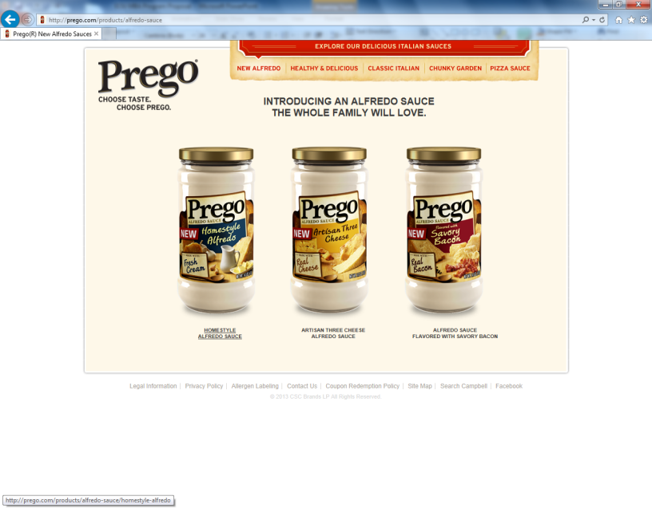
Masters Degree #2 EOU Masters in the Science of Management
Logic – Diversification of EOU COB Masters Degree product offerings.
A growth degree – opens up not-for-profit sector and non-quantitative oriented managers.
Facts: Growth in recent years has been in one-year Specialized Master of Science (MS) degrees in business, while traditional two-year MBA degrees have leveled off.
http://www.forbes.com/sites/ronaldyeaple/2012/05/30/is-the-mba-obsolete/

Slide 37
EOU COB Masters in the Science of Management Degree Options
Three New Degree Options
Key competitive advantage – one year degree or less completion – no thesis
Ability to attract individuals who do not have management experience compared to MBA degree.
Build on the Common Competency Platform similar to the MBA degree.
Use the essentially the same Common Competency Platform courses to reinforce the SUCCEED theme of the EOU Masters Business degrees:
Management and Leadership: Key Similarities, Desirable Differences
Contemporary Financial Analysis
Understanding and Unleashing Creativity
Business Endurance Principles
Personal and Professional Ethics
Note: No separate course to write the thesis will be included in the new options. A major introspective paper and PowerPoint presentation presented to a two-three person faculty member committee would replace the thesis requirement. This activity would be a graduation requirement and be included in the student’s MSM fees.
MSM – New MSM – Online MyMSM – Personalized

Slide 38
MSM Students Select 4 of the Course Options to Complete/Specialize (non-inclusive)
Crisis Preparation and Disaster Management
Anticipating, Locating and Deciphering Problems
Critical Thinking Proficiency – From Data to Information to Decisions
Blue Ocean Strategy
Management of Non-Profit Agencies
Great Management Literature – Wisdom from Classics and Great Thinkers
Historical and Contemporary Affairs – Understanding global cultures, societies, governments, legal developments, events and trends
Technological and Social Trends and Their Impact on Consumers
Talent Acquisition, Development, Retention and Deployment
Female Leadership Evolution – From Senior Executive to CEO to the Boardroom
Comprehending and Utilizing Traditional and New Media
Thriving in a Minority/Majority America and World
Marketing Strategies for Not-for-Profit enterprises.
Managing Family Owned Businesses
Protecting Intellectual Property
Not-for-Profit Agency Revenue Diversification
Managing Religious/Spiritually Based Organizations

Slide 39
MSM Degree: Speed Provides the Competitive Advantage
The MSM should follow the MBA Fast Track model and on-line platforms as they offer the speed to completion feature.
The key differences between the MBA and MSM will be admission requirements, content of two of the Common Competency Platform courses and selection the specialty options.
Students from a variety of backgrounds can migrate to the area that they wish to upgrade their skills or learn new management skills.

Slide 40
Masters Curricula Overview
SUCCEED
Common Competency Platform
On-boarding weekend
Hyper Accelerated Format
Common Curriculum Platform Courses
Management and Leadership: Key Similarities, Desirable Differences
Differentiation
4 Course/Delivery Options to Complete/Specialize
Contemporary Financial Analysis
Understanding and Unleashing Creativity
Business Endurance Principles
Personal and Professional Ethics
Introspective paper and PowerPoint presentation

Slide 41
Implementation – Spiral Spiral #1 – Years 1-3
MBA options
1 -3
Use of
e-textbooks
Addition of New Course Options
Measure results – Avoids the “all or nothing” syndrome

Slide 42
Implementation – Spiral Spiral #2 – Years 4-6
MSM
Integrate lessons learned from MBA revisions
Addition of New Specialization Options
Measure Results – avoids the “build it and they will come syndrome”

Slide 43
Key Advantages to Expanded Masters Products
MBA/MSM enrollment not reliant on traditional university enrollments.
Creation of new product space.
Protect and grow EOU MBA program equity and brand.
Create additional revenue streams – degree upgrades, summer institutes, and constantly evolving new program offerings.
Demonstrate value generation capacity of a rural university to leverage its faculty and capital resources to serve the unique needs of rural (both in Oregon, America and the world) micropolises.

